Slide 1
COATESVILLE AREA SCHOOL DISTRICT
Master Facilities Plan Community Task Force
Coatesville Area School District
Operations Committee Update
May 9, 2023

Slide 2
May 9, 2023 Agenda
Introductions
Educational Impact of Facilities
Is there a “Do Nothing Option”?
Community Task Force Final Facilities Investment Plan
Phased Facility Infrastructure Investment
Tax Impact, Examples, and Overall Budget Impact
Questions

Slide 3
Educational Impact of Facilities on Student Performance
Facility conditions
Indoor air quality, thermal comfort, acoustics, lighting, maintenance
Facility design
Building size, classroom size, natural lighting, specialty spaces, common areas, relationship of spaces to each other, aesthetic, environmental quality
Facility utilization
Functional use capacity, community access and equity throughout the district.
Notes:
Overall facility conditions are proven to be directly correlated to a students ability to learn.

Slide 4
What will happen if we do nothing?
Our financial stability is at stake.
While Coatesville is making significant progress in returning students from charter schools, we must invest in our facilities if we are to continue to bring students into our schools.
Currently, the district sends about 67 million dollars to charter schools each year. More than half of every tax dollar goes to charter schools.
Research shows that high-quality facilities, particularly at the elementary level, is one of the primary draws for families who are deciding where to educate their children.
Coatesville is already making significant progress on academics, culture, and safety. We must also focus on our facilities if we are going to remain financially viable and attract students.
Notes:
What about Equity impact.

Slide 5
Community Task Force: Priorities
Caln and East Fallowfield are beyond repair.
King’s Highway and Reeceville need renovations.
Scott cannot function as an elementary school.
A school should be located south of 30.
Classroom trailers should be removed/replaced with a permanent solution.
Campus should return to 9-10 and 11-12 setting.
6-7-8 should return to a traditional middle school setting.
Scott and North require renovations for 6-7-8 capacity.
The facilities solutions must contain two separate middle schools.
The facilities plan should be tilted towards new construction versus renovation/addition.
Notes:
This is truly a steering committee led solution. I had approached this effort as an optimization of space to help close as many schools as possible to save operational dollars and stop the bleeding in the budget. The committee took a completely different tract. They wanted to solve for the educational program problems first. Make sure that the space was conducive to improving school climate and culture second and then distill out any net savings third. All while rebuilding a crumbling infrastructure. Their view as the longer view not doing more with what we have today, but giving the educators the tools to move the needle on the other goals. This in turn will give the district a fighting chance to compete for future students. Recruiting new students into the district vastly outweighs any operation savings you will get from closing dilapidated buildings. This creates a firm foundation to further build the entire districts comprehensive plan.

Slide 6
Community Task Force: Final Facilities Option (Post Phase 1 & Phase 2)
(4) K-5 ELEMENTARY SCHOOLS
Kings Highway ES Full renovations (warm/safe/dry); remove modulars
Reeceville ES Add 8 classrooms
Rainbow ES No major work proposed (District Wide Aesthetics)
East Fallowfield ES New construction on South Brandywine Site
Caln & East Fallowfield Closed
(2) 6-8 MIDDLE SCHOOLS
Scott MS Renovations (warm/safe/dry)
N. Brandywine MS New construction (Built in 2 Distinct Phases)
CAMPUS returns to 9-10 [CAISH] & 11-12 [CASH]

Slide 7
Community Task Force: Final Facilities Option
PHASE 1 Completed
Split 6-7 population to Scott & NBMS Fall 2024
King’s Highway ES renovations Fall 2025
Reeceville Elementary School additions Fall 2025
New NBMS classroom wing (move 8th) Fall 2025
Scott renovation Fall 2026
New Elementary School Fall 2026
Close Caln and East Fallowfield ES Fall 2026
PHASE 2
Remaining NBMS new construction Jan 2029

Slide 8
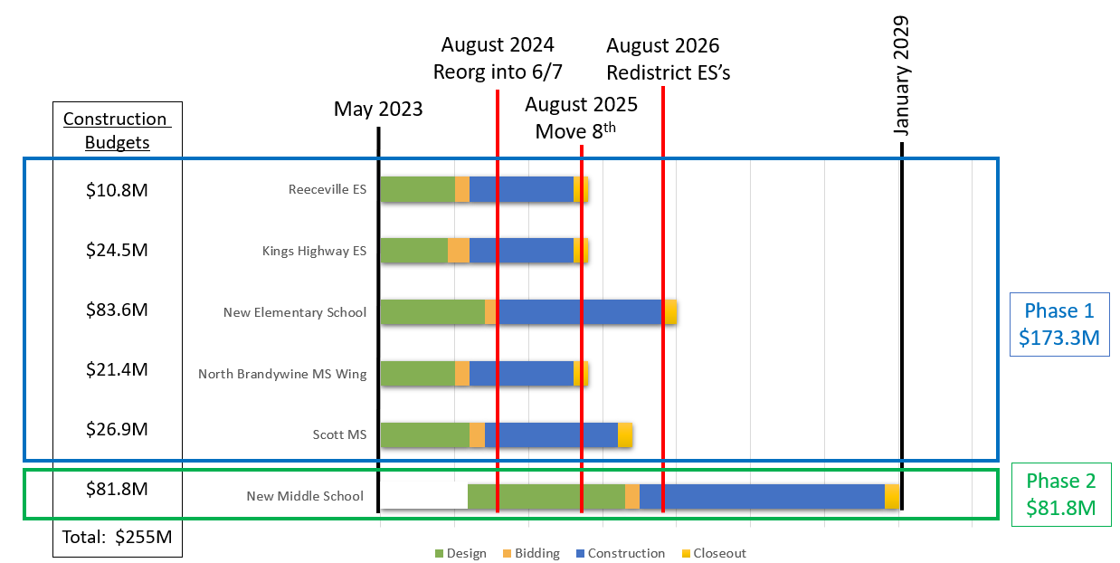
Community Task Force: Final Facilities Option
Notes:
Focus on how phasing works

Slide 9
Community Task Force: Phased Investment
Phase 1 of the Plan allows the district to completely reconfigure the grade structure.
The grade reconfiguration was identified as a key pivotal change to accelerate the “Student Achievement” portion of the district’s Comprehensive Plan
The grade reconfiguration and addition of space supports the “School Climate and Culture” portion of the Comprehensive Plan.
Allows the district to sunset two buildings that are beyond repair providing operational savings
This plan impacts all four key pillars of the Comprehensive Plan
Phase 2 completes the steering committees recommended investment by replacing the existing North Brandywine Middle School.
The board could commit to Phase 1 now and monitor the impact of this plan prior to committing to Phase 2 (Understanding that the existing North Brandywine building will still need to be addressed in some way at that future decision point).
Notes:
Phase 1 is roughly 2/3 of the cost of the total plan
Phase 2 is roughly 1/3 of the cost of the total plan

Slide 10
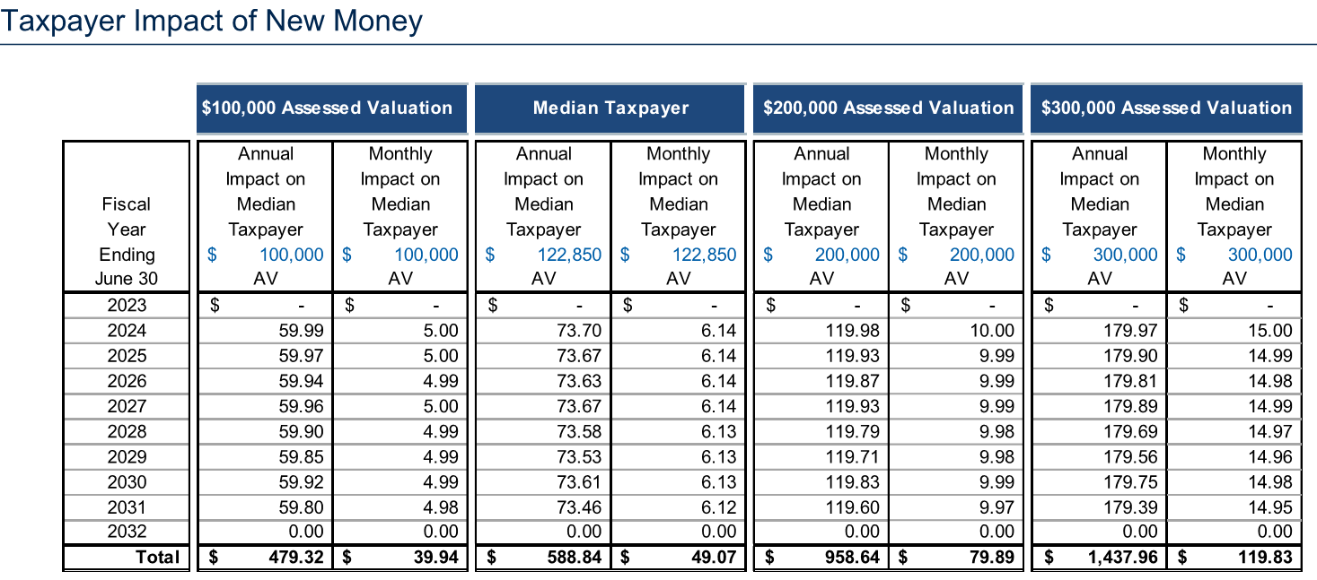
Community Task Force: Tax Impact
To fund the entire Taskforce Developed School Facility Investment Plan:
A homeowner with an assessed value of $100,000 would pay an extra $5.00 per month for the next 9 years.
A ‘median’ taxpayer with a home assessed at $122,850 would pay an extra $6.14 per month for the next 9 years.
A homeowner with an assessed value of $300,000 would pay an extra $15.00 per month for the next 9 years.
Notes:
Chester County Common Level Ratio Factor 39.5% = 2.53 multiplier – Loose approximation of market value vs. assessed. Last county wide assessment was in 1998. Median Assessed value is $122,850 of assessment which equals a rough market rate of $310,810 as a market rate.
$319,900 = 3 bd3 ba1,736 sqft
58 Cynthia Rd, Coatesville, PA 19320
Single family residence
Built in 2001
Forced air, natural gas
Central a/c, natural gas
1 Attached garage space
0.36 Acres

Slide 11
Community Task Force: Tax Impact Sample Homes
Sample Housing Data and Tax Impact (Current Homes for Sale on Zillow 5/4/23)
Assessed Value Sample (From RBC Chart) | Typical Home in this Category | Market Value (Listing Price) | Actual Assessed Value | Tax Impact in ($/Month)
$100,000 | 1,536 SQFT Townhome with 3 bedrooms, 3 bathrooms built in 2002 | $255,000 | $102,510 | $5.13
$122,850 (Median) | 1,736 SQFT Single Family Home with 3 bedrooms, 3bathrooms built in 2001 | $319,900 | $114,380 | $5.72
$300,000 | 3,491 SQFT Single Family Home with 4 Bedrooms, 4 Bathrooms built in 2020 | $650,000 | $284,240 | $14.21
House data above from Zillow (houses currently on the market)
Assessed value of each property is determined by Chester County
The last assessment of property values was performed by Chester County in 1998
Notes:
Chester County Common Level Ratio Factor 39.5% = 2.53 multiplier – Loose approximation of market value vs. assessed. Last county wide assessment was in 1998. Median Assessed value is $122,850 of assessment which equals a rough market rate of $310,810 as a market rate.
$319,900 = 3 bd3 ba1,736 sqft
58 Cynthia Rd, Coatesville, PA 19320
Single family residence
Built in 2001
Forced air, natural gas
Central a/c, natural gas
1 Attached garage space
0.36 Acres

Slide 12
Community Task Force: Overall Budget Impact
Included in the Preliminary Budget:
Tax impact of existing debt per RBC’s presentation
Tax impact of proposed new debt to fund this plan per RBC’s presentation
Operational/Educational costs outside of debt
Ideally, this plan helps to brings money back into the district’s coffers
The Preliminary Budget has been presented at previous board meetings with the costs above included.
Notes:
Chester County Common Level Ratio Factor 39.5% = 2.53 multiplier – Loose approximation of market value vs. assessed. Last county wide assessment was in 1998. Median Assessed value is $122,850 of assessment which equals a rough market rate of $310,810 as a market rate.
$319,900 = 3 bd3 ba1,736 sqft
58 Cynthia Rd, Coatesville, PA 19320
Single family residence
Built in 2001
Forced air, natural gas
Central a/c, natural gas
1 Attached garage space
0.36 Acres

Slide 13
Q & A
THANK YOU!
Notes:
What else do you need to know to make a decision?

